Slide 1

University Planner
Naveen Kumar Chandaluri

Slide 2
Contents
Problem Statement
Proposed Solution
Application Features
Activity Description
Persistent data Storage
API’s
Problems
Future Enhancements

Slide 3
Problem Statement
In the real time there is no android application to get the basic requirements of a particular university in United States.
We need to go each university website to know the admission requirements of course.
It takes more time to find the list of universities in the particular state.
Naveen Kumar
Notes:
The existing system is not a computerized system. Each university has its own individual dtatabase and it’s a time taking process to go to each website to find about its details.
Also, It’s a a time taking process to find all the list of universities in a particular state in the US.

Slide 4
Proposed Solution
Easy to use.
A Mobile application design to have all the universities list information for international students who want to pursue Masters in abroad.
Find all the universities list in one application
Will get the minimum scores required for university admission.
Naveen Kumar
Notes:
To overcome this problem we’ve proposed our solution where we have designed a mobile application that uses a centralized database.
The “University Planner” is a native android application that brings change to the conventional method of searching Universities and their requirements manually.
This provides a list of all the universities and their minimum requirements like gre. Ielts and toefl score.
Maintaining all the information in online systems database makes it very easy to access and retrieve data from the database.
So a single application provides all the information about a particular chosen university, hence reducing the time and effort of the user.

Slide 5
Application Details
Two Android Applications
University Planner Admin
University Planner User
Naveen Kumar

Slide 6
Features for Admin
Completed Features
Admin can launch the application directly from the mobile gallery.
We can login as admin to have all the privileges.
Create details of the Universities and their courses.
Update details of the Universities and their courses.
Delete details of the Universities and their courses.
Naveen Kumar

Slide 7
Features for User
Completed Features
User can launch application directly from the mobile gallery.
User can retrieve the details of the university and course based on there preferred state.
User can get the information about the requirements of the University like minimum GRE score, IELTS/TOEFL score, etc.
Naveen Kumar
Notes:
User does not need to register to get started with the application.
After user launch the application, he is provided with selection tab where he can search for the Universities and their requirements based on the state he entered.
As the user selects the state he is provided with a list of all the universities in that state.
As the user selects a particular University, he is provided with a description of all the courses it offers.
It also provides information about the requirements of the University for a particular course like minimum GRE score, IELTS/TOEFL score, etc.

Slide 8
Device Support and Credentials
Supported devices:
google nexus 5 – 4.4.4
API Level - 19
Resolution: 1080X1920
Test Credentials
User Name: admin@gmail.com
Password: admin123
Naveen Kumar

Slide 9
Persistent Data Storage
A Common database for both the Admin and User applications
i.e. Google Fire Base.
Firebase is a Backend-as-a-Service — BaaS
Firebase is a mobile platform that helps you quickly develop high-quality apps.
Naveen Kumar
Notes:
There is a common database for both the applications i.e Google FireBase.
Firebase is a mobile and web application development platform developed by Firebase, Inc. in 2011, then acquired by Google in 2014.^{[5]}

Slide 10
The Firebase
The Login module uses the Authentication feature.
Store the State , University , Course , GRE, TOFEL and IELTS details.
This module uses the Real-Time Database feature.
It is a JSON-database.
Very easy to handle data compared to SQL
Naveen Kumar
Notes:
Firebase Auth is a service that can authenticate users using only client-side code.
Firebase provides a realtime database and backend as a service. The service provides application developers an API that allows application data to be synchronized across clients and stored on Firebase's cloud.
Firebase Storage is backed by Google Cloud Storage.

Slide 11
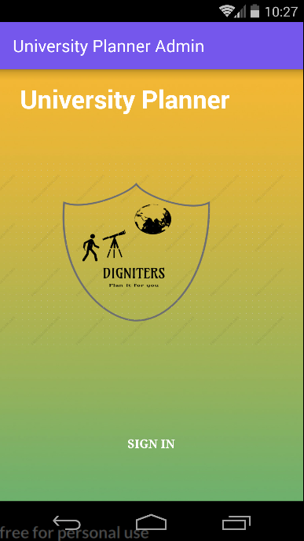
Activity Description
Admin
On Launch Activity
This is the main activity for the admin Module.
It allows the admin to sign in from this page.
Naveen Kumar
Notes:
This is the admin application so he doesn’t need to register. He can directly click on the sign in which redirects to the next page were e can give the login credentials to sign in.

Slide 12
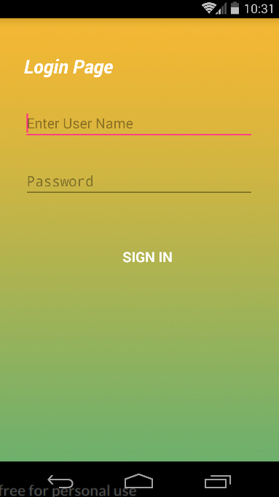
On Start Activity
Admin enters his username and password and signs in.
Naveen Kumar
Notes:
Login credentials are in the database and we can sign in directly using those credentials.

Slide 13
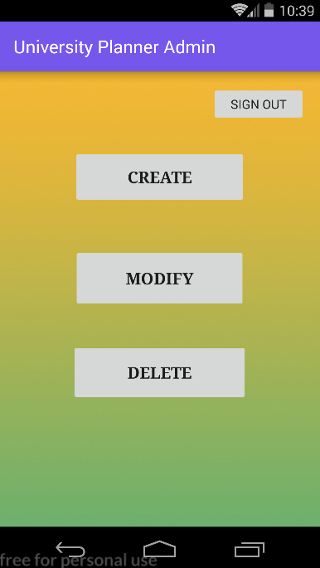
Basic Activity
The admin can either create modify or delete
the details of the university.
Naveen Kumar
Notes:
After signing in, another page is redirected where there are three features i.e create, modify and delete.
By clicking on each of these buttons, it would be redirected to those particular pages.

Slide 14
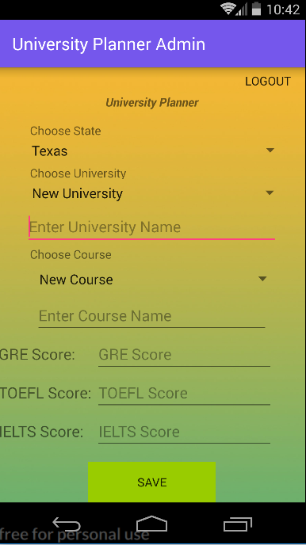
Create University details activity
The user admin can choose the state to which he wants to add the university.
There are five fields in this page where the admin enter the university name, course name, GRE course, TOEFL score and IELTS score.
Naveen Kumar
Notes:
By clicking on the create button, this page will be redirected.
He can choose the state predefined in the database.
He can choose new university and enter the name of the university he wants to add.
He can choose new course and enter the name of the course he wants to add.
In the fields specified he can add the GRE, TOEFL and IELTS score.

Slide 15
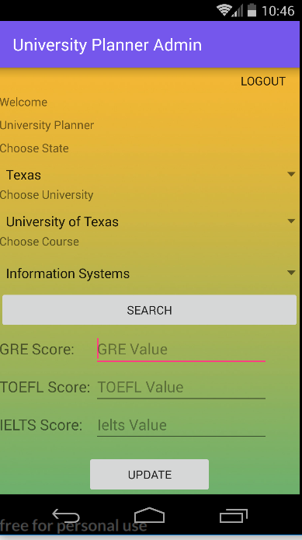
Update University Details Activity
Admin can search the university details from the available dropdown and update the scores.
Naveen Kumar
Notes:
From this page, the admin can modify the details of the universities.
By selecting the university name and specific course and click search, the admin will be able to modify the scores.

Slide 16
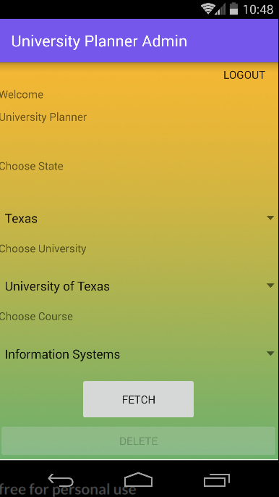
Delete University Details Activity
Admin can delete the university details from this page.
Naveen Kumar
Notes:
This page allows the admin to delete the details of the university.
The data is fetched by clicking on the fetch button and by clicking on the delete button, the selected university will be deleted.

Slide 17
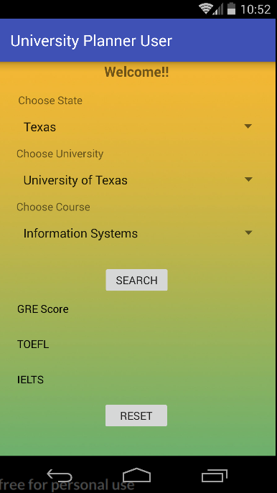
User Main Activity
The user can choose the state, university and course from this page to gets get the scores required.
Naveen Kumar
Notes:
This is the main activity of the user.
After choosing the state, university and course and clicking on the search button, the scores are displayed on the screen.
Reset button is used to go back so that the user can search for the details of other universities.

Slide 18
Problems faced
Connecting to the database.
Fetching real time data.
Storing real time in data cloud.
Updating data in the cloud.
Deleting data from the cloud.
Naveen Kumar

Slide 19
Future Enhancements
Adding loads of data in the cloud.
Implementing search engine.
Adding contact information of the Universities.
Naveen Kumar

Slide 20
DEMONSTRATION

Slide 21
Conclusion
This app is very useful to students who are looking for university admissions in abroad. This will give a clear picture about the scores, universities list and source to the website.

Slide 22
Acknowledgement
We thank Dr. Charles Hoot Jr for providing this opportunity to explore our knowledge and also our Graduate Assistant Shiva Teja Miyapuram was helpful throughout our completion of project.

Slide 23


